Slide 1
Webs – Workflow case

Slide 2
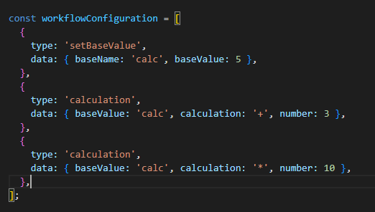
Goal: Make it easy to create custom workflows
Library of Workflow Steps
Workflow
WorkflowConfiguration
Step A
Step B
Step C
Step ..
Step ..
Need to be possible to execute the same step multiple times
Step ..

Slide 3
Key Philosophies
Use standardized classes to make classes comparable and modular
First validate than execute
Store data in a smart and reliable way

Slide 4
Use standardized classes

